Slide 1
HI THIS IS JAI PRAKASH
THE CAPSTONE PROJECT ON E-COMMERCE COMPANY

Slide 2

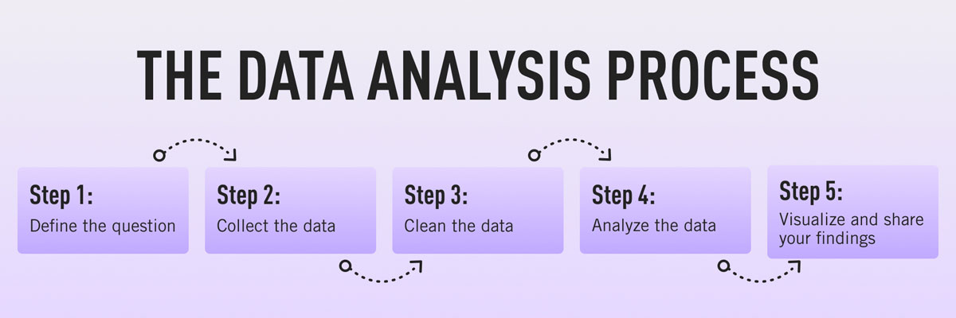
CONTENT
Defining the question
Collecting the data
Cleaning the data
Analyzing the data
Sharing your results
Embracing failure
Summary

Slide 3
DIFINING THE QUESTION FOR ECOM data 1.HOW TO SALE MORE PRODUCT ? 2.HOW TO REDUSE LABOURE COST AND SHIPPING COST ? 3.HOW TO INCREASE PROFIT IN MARKET ? 4.HOW TO REDUSING TARNSPORTATION COST ? 5.HOW TO COMPETE OTHER E COMMERCE COMPANY ? 6.HOW TO MANAGE COURIER PARTNERS ?
TOOLS
1. USING MS EXCEL TO MAKE DECEISIONS AND MS POWERPOINT FOR SUMMARY
COLLECTING THE DATA
Once you’ve established your objective, you’ll need to create a strategy for collecting and aggregating the appropriate data. A key part of this is determining which data you need. This might be quantitative (numeric) data, e.g. sales figures, or qualitative (descriptive) data, such as customer reviews. All data fit into one of three categories: first-party, second-party, and third-party data. Let’s explore each one
CLEANING THE DATA
1.Removing major errors, duplicates, and outliers—all of which are inevitable problems when aggregating data from numerous sources.
2.Removing unwanted data points—extracting irrelevant observations that have no bearing on your intended analysis.
3.Bringing structure to your data—general ‘housekeeping’, i.e. fixing typos or layout issues, which will help you map and manipulate your data more easily.
4.Filling in major gaps—as you’re tidying up, you might notice that important data are missing. Once you’ve identified gaps, you can go about filling them.

Slide 4
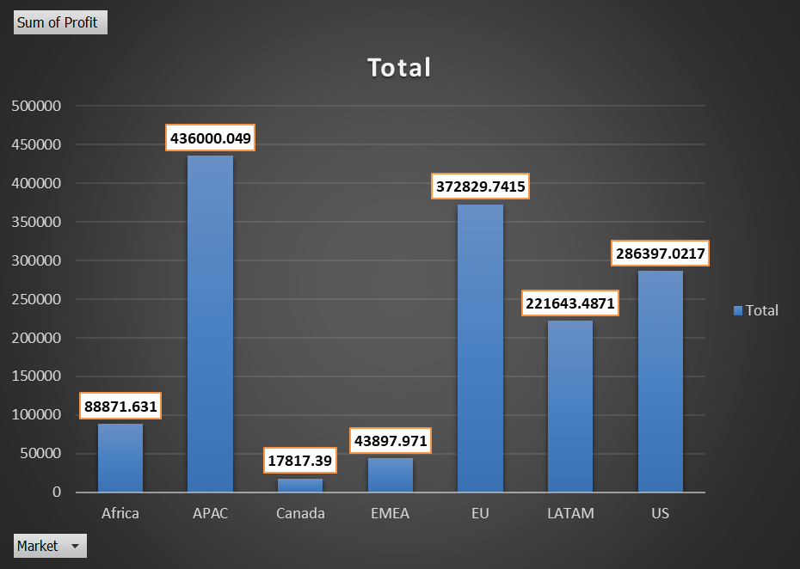
Analyzing the data
ANAALYSING BY BAR CHARTS
THIS IS CKLEARLY SHOWS THAT APAC IS MAKE MORE PROFIT AND THERE IS SLIGHTLY DAWNFALL PROFIT IN CANADA
FIND THE WAYS OF INCRESE IN PROFIT AND SALING THE MORE PRODUCT IN CANADA
I THINK THEQUANTITYRE IS SHIPPING COST IS MAKE AFFECT OF QUANTITY
Sum of Profit
Market | Total
Africa | 88871.631
APAC | 436000.049
Canada | 17817.39
EMEA | 43897.971
EU | 372829.7415
LATAM | 221643.4871
US | 286397.0217
Grand Total | 1467457.291

Slide 5
analysis by py chart by quantity sold and returns
there is three market
Canada(1%) quantity sold
Emea (6%) quantity sold
africa (6%) quantity sold
Row Labels | Sum of TOTAL SALE QUANTITY | Sum of RETURN QUANTITY
Africa | 10564 | 0
APAC | 41172 | 54
Canada | 833 | 0
EMEA | 11517 | 0
EU | 37712 | 61
LATAM | 38494 | 32
US | 37829 | 44
Grand Total | 178121 | 191

Slide 6
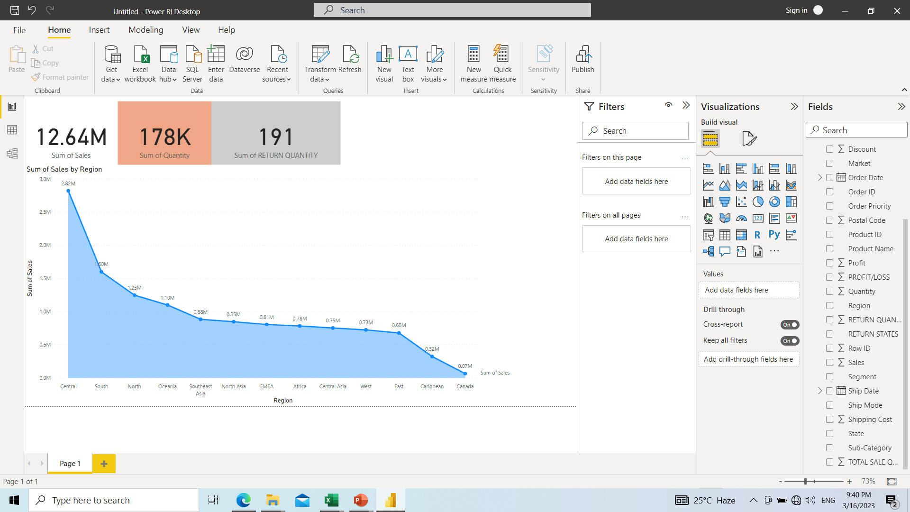

Slide 7
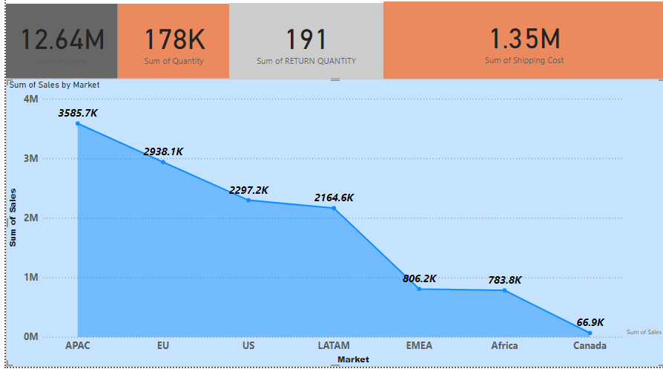

Slide 8
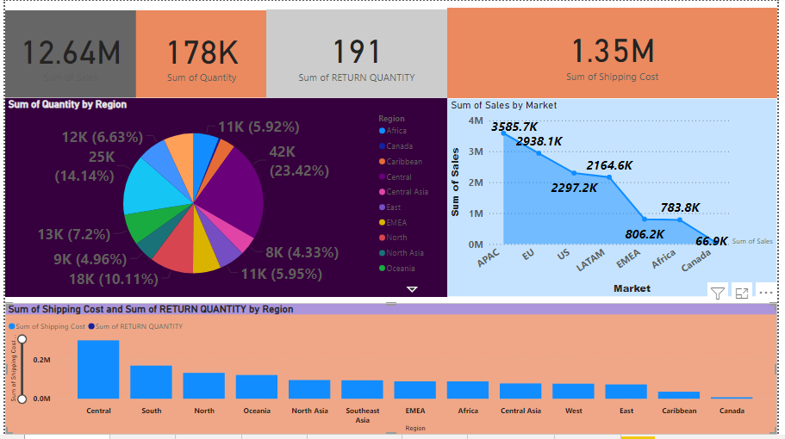

Slide 9
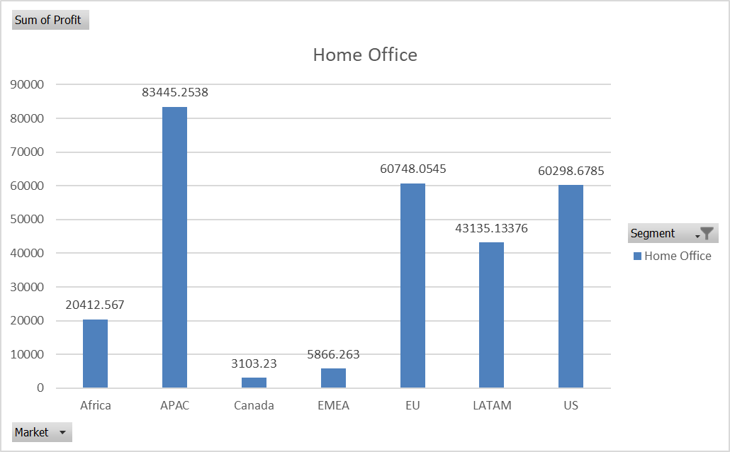
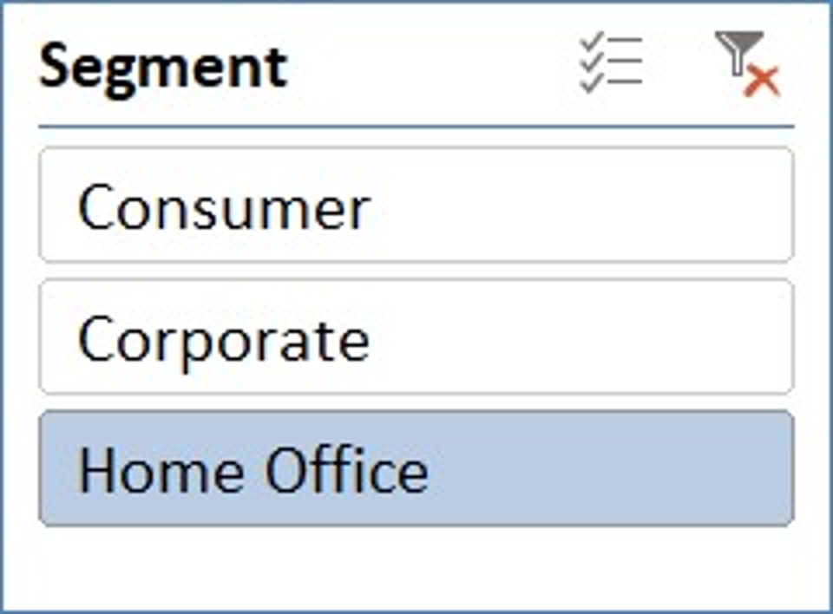
Sum of Profit | Segment
Market | Home Office | Grand Total
Africa | 20412.567 | 20412.567
APAC | 83445.2538 | 83445.2538
Canada | 3103.23 | 3103.23
EMEA | 5866.263 | 5866.263
EU | 60748.0545 | 60748.0545
LATAM | 43135.13376 | 43135.13376
US | 60298.6785 | 60298.6785
Grand Total | 277009.1806 | 277009.1806

Slide 10
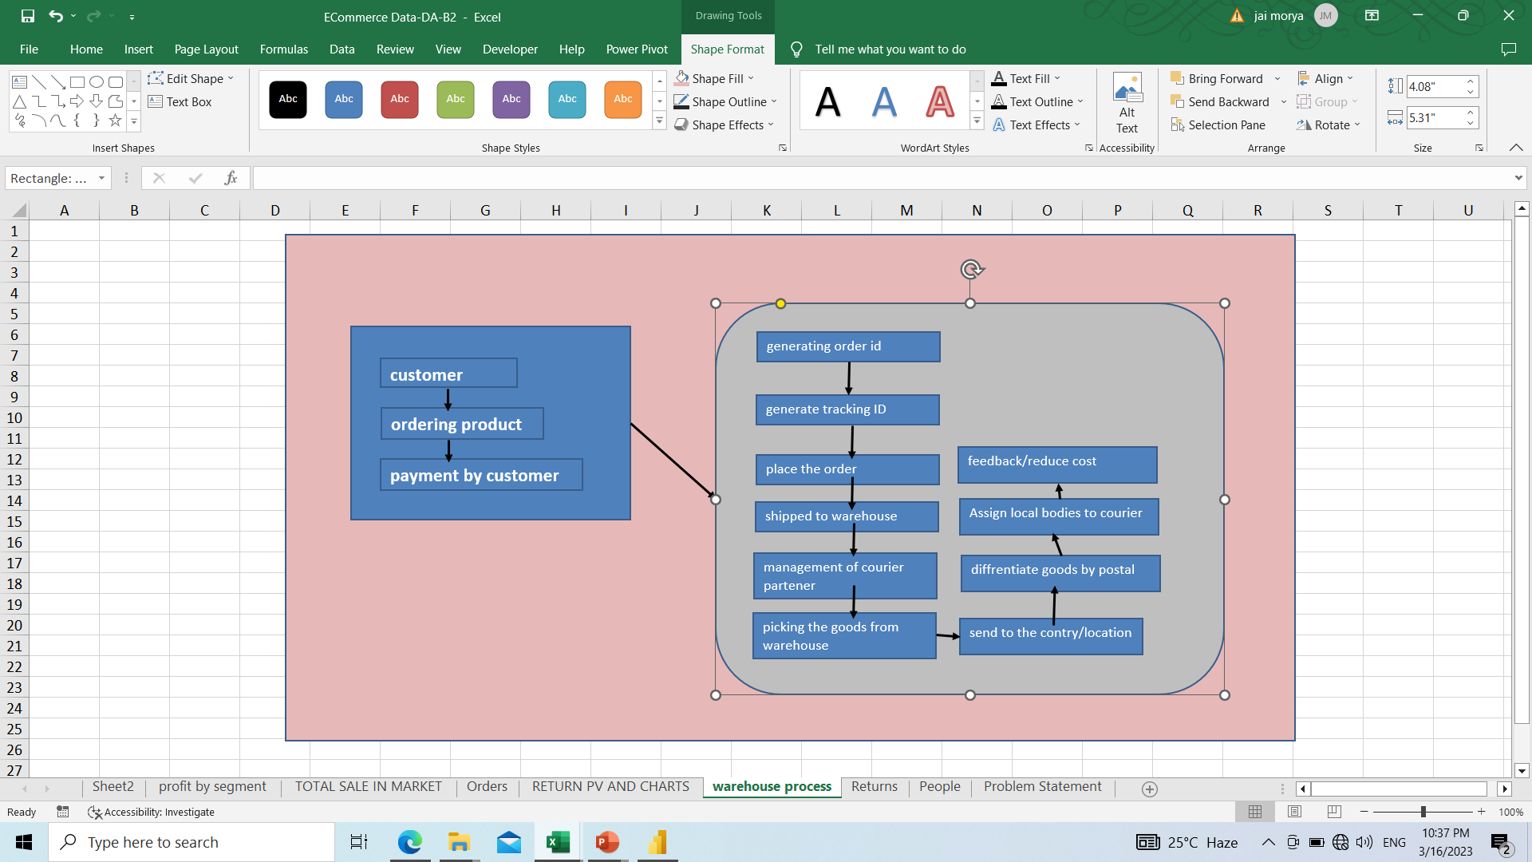
warehouse
By collecting the data we assume that the charts and reports are accurate
From the reports and charts shows that quantity sold in every market is good excepts Canada. so we have to make a warehouse management system so that the goods is easily available to the customer in same day/on time

Slide 11
CONCLUSSION/BUSINESS MOTIVE
Firms are organisations often involving thousands of people directly, with millions of people indirectly involved. Not all people directly or indirectly involved in an enterprise have the same goals or gain the same rewards. For example, entrepreneurs take business risks and expect a profit from their entrepreneurial skill and effort whereas managers, who are appointed by owners to make decisions, are not rewarded with profits. Managers receive a salary and other benefits, such as a company car, and may be motivated to maximise revenue, out of which salaries and other benefits are paid. Employees, and the unions they belong to, will hope the business survives so that they retain their employment in the long run and pay a decent wage. The local community will hope the business provides jobs, without generating excessive external costs. The government will also hope that firm’s survive, prosper, and grow as their tax revenues depend on this happening.
.WE HAVE TO DECREASE SHIPPING COST BY ANALYSIS OF PY CHART THIS IS CLEARLY SHOWS THAT CANADA HAS VERY LOW SALE OF HOME OFFICE ONLY 1 %
AND WE HAVE TO IDENTIFY CAUSES OF LOW SALE
.IT MIGHT BE
1 LOW POPULATION
2.DEMANAD AND SUPPLY
3. TRANSPORTATION COST.
4 LABOUR COST.
5. AFTER SALE SERVICES

Slide 12
Links
Github links for powerBI projects
https://github.com/prakashmorya/powerBI/blob/main/capstone%20data.pbix

